Slide 1
The Power of Thinking Outside the Box to Meet the Diverse Needs of School Communities Aspiring School Leaders Regional Education Conference 2017
Carol Sparber, Ph.D.

Slide 2
Objectives
Engage in research-based instructional strategies to include all students
Understand the significance for using research-based strategies in teaching and instruction
Learn how to implement research-based instructional strategies

Slide 3
Turn on your brain…
Directions: In the following line of letters, cross out six letters to that the remaining letters – without altering their sequence – spell a familiar English word.
B S R I A X L E I T N T E R S
Hint: If you’re having difficulty, go back and read the directions very carefully again.

Slide 4
Answer
B S R I A X L E I T N T E R S
…BRAIN
Notes:
Did you know….How the brain works has a significant impact on what kinds of learning pg activities are most effective. Educators need to help students have appropriate experiences and capitalize on those experiences.

Slide 5
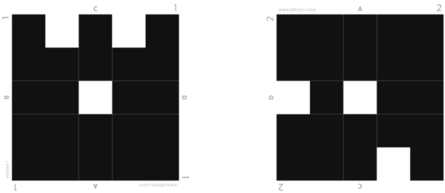
Plickers Assessment

Slide 6
Teach Teachers how to create magic
Christopher Edmin: Teach teachers how to create magic

Slide 7
Story Time: setting the stage

Slide 8
What diverse needs are we facing?
A classroom with a variety of student needs….
gifted and talented
students with specific learning needs
Students on IEPs
Students from a variety of cultural backgrounds
Students from a variety of socioeconomic backgrounds

Slide 9
For example…
Connor likes coming to school because people don’t yell all the time – no one hits at school either, and if they do, they get in trouble
Katie knows she doesn’t learn like other kids. She has an aide who helps her in class. She doesn’t like feeling different.
Timmy hates reading. He misbehaves sometimes – not that he wants to, but because he doesn’t want to appear ‘stupid’ in front of everyone.

Slide 10
For example…
Emma reads her mom’s novels at home. She likes to write short stories in her free time. At school she’s working well above grade level.
Keh Keh is a refugee from Burma. She has an ELL tutor and is learning English but she has difficulty understanding the teacher and is uncomfortable asking questions.
Petra enjoys learning and wants to participate in classroom discussions – but he doesn’t. His friends say school is not for kids like them. Learning is for other kids, so why should he bother. He’ll never go to college anyways.

Slide 11
Student Characteristics in a mixed-ability classroom
Strengths
Superior Vocabulary
Highly creative
Resourceful
Curious
Imaginative
Questioning
Problem-solving ability
Sophisticated sense of humor
Wide range of interests
Advanced ideas & opinions
Special talent or consuming interest
Challenges
Easily frustrated
Stubborn
Manipulative
Opinionated
Argumentative
Difficulty with written expression
Highly sensitive to criticism
Inconsistent academic performance
Lack of organization and study skills
Difficulty with social interactions
Language barriers

Slide 12
Principles of learning
Learners must make meaning of what teachers seek to teach (National Research Council, 1999)
Learning takes place most effectively in classrooms where knowledge is clearly and powerfully organized (National Research Council, 1999)
Learners are actively engaged in the learning process (Wiggins & McTighe, 2005)
Learners need to feel a sense of safety and connection (Wiggins & McTighe, 2005)
Notes:
We know a lot about how people learn. We know that each learner must make meaning of what teachers seek to teach. We know that the meaning-making process is influenced by the student's prior understandings, interests, beliefs, how the student learns best, and the student's attitudes about self and school.
We know that learning takes place most effectively in classrooms where knowledge is clearly and powerfully organized, We know that learning takes place when students are highly active in the learning process.
(Vygotsky) Learning happens best when a learning experience pushes the learner a bit beyond his or her independence level. When a student continues to work on understandings and skills already mastered, little if any new learning takes place. On the other hand, if tasks are far ahead of a student's current point of mastery, frustration results and learning does not.
(Piaget)We know that motivation to learn increases when we feel a kinship with, interest in, or passion for what we are attempting to learn.

Slide 13
How are we going to get students with diverse needs engaged?
Notes:
On the sticky notes write down what your partner says.

Slide 14
Commonly suggested strategies
Use preferential seating
Provide organizational techniques
Teach compensation strategies
Use technology
Notes:
Compensation strategies include: study strategies, cognitive strategies (also called learning strategies), compensatory supports (e.g., tape recorders and computer word processing programs), and environmental accommodations such as test-taking accommodations (e.g., extended test time, less distracting test-taking setting) Specific learning strategies (e.g., repetition, verbal elaboration, organization techniques, paraphrasing, association) & self-regulation.

Slide 15
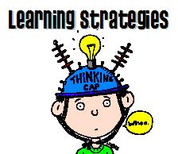
Introducing…
Practical, research-based instructional strategies
Based on principles of universal design for learning
Support and enhance all student’s academic success
Research indicates that content instruction paired with specific learning strategies improves learning for all students
Notes:
Research indicates that content instruction paired with specific learning strategies improves student learning (Ellis, 2005)

Slide 16
Question That
Question That
Notes:
Add sticky notes to the ‘question that’ board

Slide 17
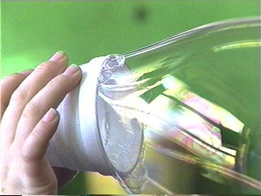
To stretch thinking: Add a criterion (3,2,1) 3 Things I notice, 2 Things I infer, 1 Question
Notes:
Use pictures – then to stretch thinking, add a criterion

Slide 18
Analysis Grid: Find the Flaw
Notes:
Provides great opportunity to engage in academic conversation. Students can work independently, in pairs, or in small groups. This example is for English, punctuation errors.
How could you use this in a different discipline?

Slide 19
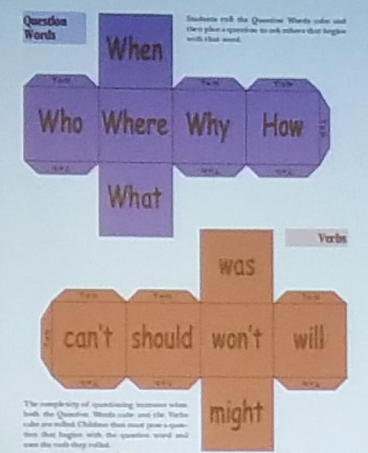
Low Prep High Impact Differentiation
Question Cubes
Notes:
Students become producers of knowledge
Active learning
Mentally engaged
High-level thinking and complex responses
Can be used with multiple content, skills and topic applications
Research-based

Slide 20
Lesson Organizer (follow number order) Date:
3. Last Unit: (review last unit/ lesson)
1. Current Unit: (introduce using title)
4. Next Unit: (show how unit/lesson leads to next)
5. Big question:
(Discuss why this unit/lesson is important and relevant)
6. The Key Concepts
(3-6 short ideas-use back to show relationships or subheadings)
2. What is this about? (Discuss with Students)
USE
SHORT
& COLORS
EASY
NAMES
7. Self-test questions
8. Unit Schedule
(Describe what should students be able to do after studying
this unit)
(Describe key activities and
timelines)
Notes:
Method for Presenting Content:The Lesson Organizer

Slide 21
Share & debrief

Slide 22
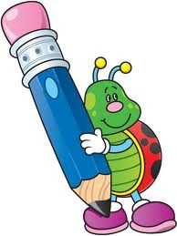
Spelling: Color Coded Cards

Slide 23
Key word Mnemonics
Mnemonics: good for remembering facts or events
Connects new learning to prior knowledge through the use of visual cues
HOMES” to remember Great Lakes, Huron, Ontario, Michigan, Erie, and Superior
PEMDAS – to remember the order of operations: parentheses, exponents, multiply, divide, add, subtract
When mnemonics are used correctly, they can streamline the learning process, giving students access to broad amounts of information. Because they learn "bridges" to other information, less working memory is required.

Slide 24
How these techniques help you as a teacher
supports in-depth thinking
less frustrated students
students are engaged
fewer students feeling distracted by other students
promotes student achievement without extensive individual interventions

Slide 25
Brain Break

Slide 26
The LINCing Routine

Slide 27
Purpose of the LINCing Routine
To help a diverse group of students learn and remember the meaning of important terms.
Gets students ready to learn new terms
Co-construct visual and auditory memory devices
Check student understanding

Slide 28
What the Research says about the LINCing Routine
Extensively researched
Promotes understanding and recall of an important vocabulary term
Highly effective with ALL students
When consistently used with students for 3 weeks, students w/LD increased vocabulary scores 24%-29%
Students without LD increased vocabulary scores 16% – 19%
Most effective with middle school – high school age students, can be used effectively with upper elementary

Slide 29
Mnemonics using LINCing Routine

Slide 30
Mnemonics using LINCing Routine
Step 1. The term: discuss and define the meaning of the word within the context of the lesson. Record the term on the form.
Term
Discount

Slide 31
Mnemonics using the LINCing Routine
Step 2. A brief definition is written in section 2. Use ONLY the parts of the definition that are most essential for students to know. (reduce long definitions to their most essential parts)
1. Term
Discount
2. Definition
The difference between the list price and sale price

Slide 32
Mnemonics using LINCing Routine
Step 3 The reminding word gives students auditory clues that will enable the to access their memory of the new term and the new term’s definition. It must SOUND similar to part of all of the new term, and it must be a real word whose meaning is very familiar to the students. It should help you remember what the new word means.
1. Term
Discount
2. Definition
The difference between the list price and sale price
3. Reminding Word
Disc

Slide 33
Mnemonics using LINCing Routine
Step 4 The LINCing story is a short phrase or sentence that enables students to connect or link the meaning of the new term to familiar background knowledge.
It provides auditory and visual links between the reminding word and the meaning of the new term.
AN EFFECTIVE story includes several characteristics:
the story always contains the reminding word, the story always contains the meaning of the new term in some way, the story is always short and simple.
1. Term
Discount
4. The LINCing story
I saved three dollars on a disc
2. Definition
The difference between the list price and sale price
3. Reminding word
Disc

Slide 34
Examples and Nonexamples
Decree: to make a decision and force it on others. Reminding word: Decide LINCing Story: “the dictator decided to force everyone to pay higher taxes.” (The story helps you think of a decision being forced on others.) ______________________________ Flourite: a purple mineral used to make steel hard. Reminding word: Floor LINKing Story: “My knee turned purple when it hit the hard, steel floor.” (Story helps you think of steel and the color purple.) | Decree: to make a decision and force it on others. Reminding word: Decide LINCing Story: “He decided to go to town.” (Story does not help you think of forcing a decision on others.) ______________________ Flourite: a purple mineral used to make steel hard. Reminding word: Floor LINKing Story: “The floor was messy.” (Story does not help you think of steel or the color purple.)

Slide 35
Step 5 The LINCing picture provides a visual memory link for the new term.
The picture does not need to be sophisticated artwork – stick figures are fine.
The linking pictures must include 3 characteristics: It MUST depict: a part related to the Reminding word, contains parts related to the important ideas in the definition, and it must help the student remember the new term’s definition.
1. Term
Discount
4. The LINCing story
I saved three dollars on a disc
5. The LINCing picture
2. Definition
The difference between the list price and sale price
3. Reminding word
Disc

Slide 36
An Effective LINCing Picture

Slide 37
Group practice: Term ‘compromise’
Term
compromise
4. Story
5. Picture
2. Definition
3. Reminding Term

Slide 38
Mnemonics using LINCing Routine
USE the Mnemnic to practice the Routine
List the parts
Identify a Reminding word
Note a LINCing story
Create a LINCing picture

Slide 39
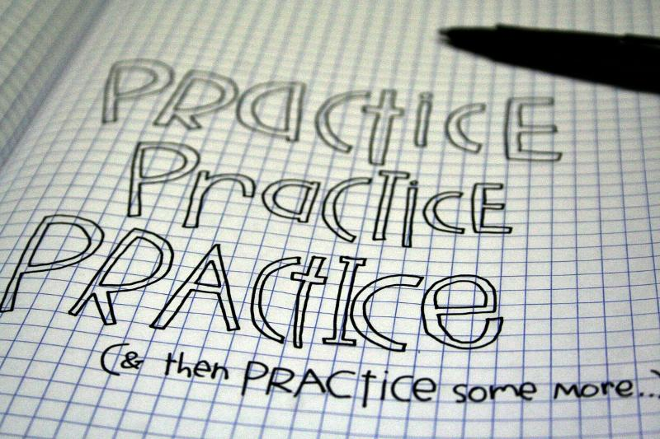
Time to practice

Slide 40
Word Choices
Amendment Serpentine Clamor
Charitable Countenance Tremulous
Mortified Grotesque Allude
Tirade Exquisite Placid
Perpetual Melancholy Amiable
Wholesale Incredulous Venerate
Abolitionist Perplex Undulate

Slide 41
Share & Discuss

Slide 42
Why would this instructional strategy engage all students?
Notes:
Visual graphs/charts support learning
Frames relationships
Show the ‘parts’ of the ‘whole’
Incorporates organizational activities into classroom activities
Breaks learning into steps
Helps students synthesize information
Organizes learning

Slide 43
Wrap Up
Strategies
Question That
3,2,1
Analysis Grid
Cube Questions
Graphic Organizers – color coded
Color coded spelling words
Mnemonics

Slide 44
More information
http://www.livebinders.com/play/play?id=2163392
Instructional Strategies for Mixed Ability Classrooms
Contact information:
Carol Sparber Ph.D.
150 Terrace Drive, 202 White Hall
Kent, OH 44242
330-672-0723
csfeldma@kent.edu

Slide 45
References
Burden, P. R., & Byrd, D. M. (2015). Methods for effective teaching: Meeting the needs of all students. Pearson.
Dack, H., & Tomlinson, C. A. (2015). Inviting all students to learn. Educational Leadership, 72, 10-15.
Ellis, E. (1992). The LINCS Vocabulary Strategy, Lawrence, KS: Edge Enterprises, Inc.
Hattie, J. (2012). Visible learning for teachers: Maximizing impact on learning. New York: Routledge.
Lucariello, J. M., Nastasi, B. K., Anderman, E. M., Dwyer, C., Ormiston, H., & Skiba, R. (2016). Science supports education: The behavioral research base for psychology's top 20 principles for enhancing teaching and learning. Mind, Brain, and Education, 43, 112-123.
National Research Council. (1999). How people learn: Brain, mind, experience and school. Washington, DC: National Academies Press.
Wiggins, G. P., & McTighe, J. (2005). Understanding by design. Ascd.

