Slide 1
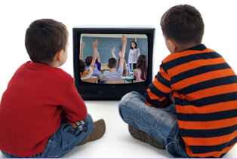
Using Video Modeling to teach Employment related social skills to individuals with moderate/intensive needs
Carol Sparber, Ph.D.
Rachel McMahan Queen, Ph. D.

Slide 2
What is Video Modeling?

Slide 3
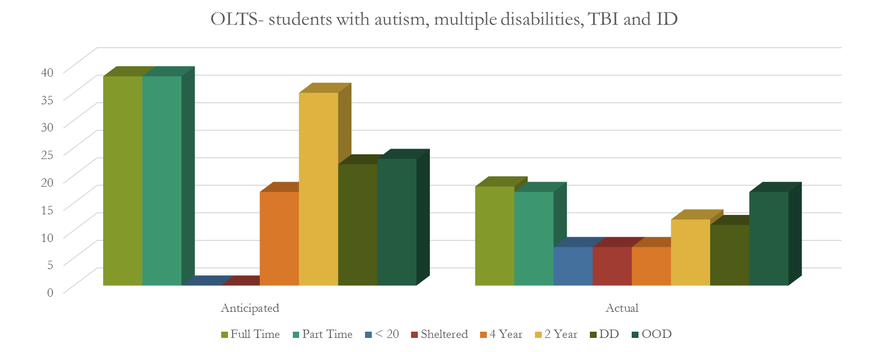
Postschool outcome data
N=1932

Slide 4
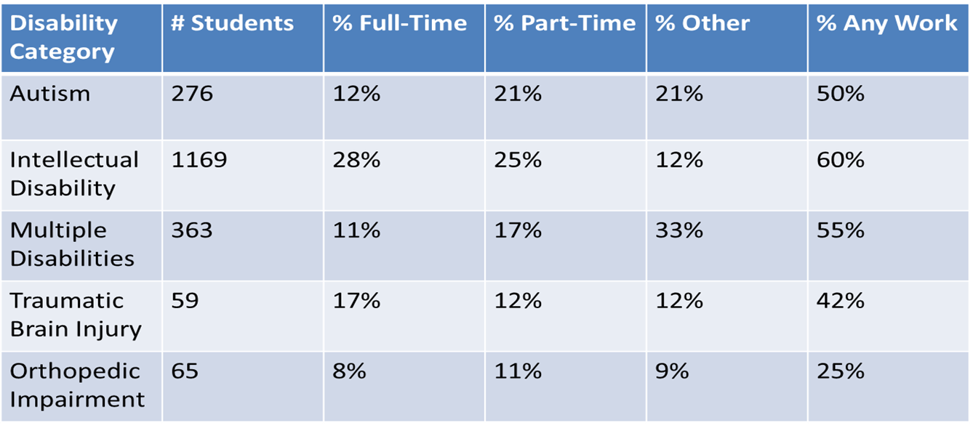
Employment outcomes 2006-2013

Slide 5
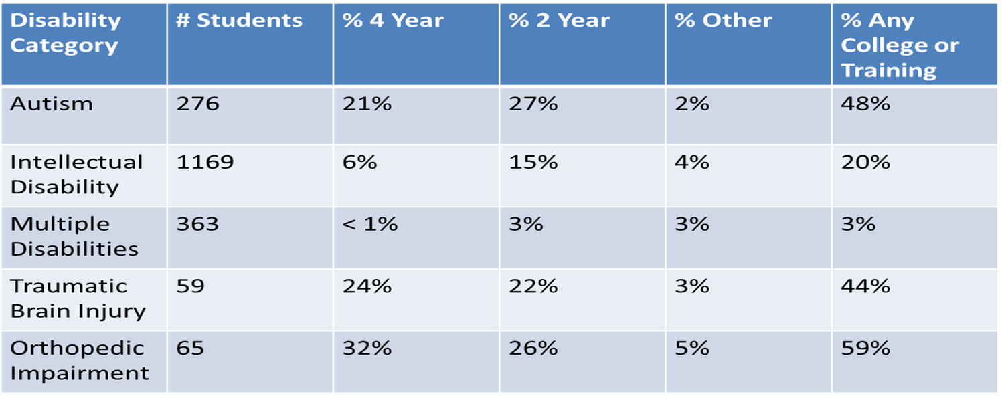
Postsecondary outcomes 2006-2013

Slide 6
Reasons for not doing as planned
Working | N | Postsecondary Education | N
In school | 199 | Changed plans | 200
No job of interest | 100 | Not enough money | 167
No job at all | 233 | Needed help applying | 45
Need help | 67 | Was not accepted | 15
Lack required skills | 77 | Did not have required courses | 23
Transportation problems | 95 | Other | 413
Worried to lose benefits | 100
Don’t want to work | 95
Other | 256

Slide 7
Other reasons
Working – Other | Postsecondary Education - Other
Adult services not in place Attending adult activity center No availability opportunities for adults with significant disabilities Pregnancy/Currently on maternity leave Medical issues Mental health problems In training through BVR Lost job/Fired/Laid off Not going to work with [those people] Not capable Unable to work Volunteering Incarceration | Low cognitive ability Don’t know Applying for fall Pregnancy Behavior issues Could not handle – just too much Could not handle the academic requirements Could not read Did not apply Did not intend to go Too severe a disability Postsecondary couldn’t provide supports Too difficult/unable to attend

Slide 8
What is Video Modeling?
a strategy in which a teacher, parent, or practitioner shows a video of desired behaviors or interactions to an individual student or a small group of students.
The student then imitates the behavior or interaction when in the appropriate situation (Bellini & Akullian, (2007).
Notes:
VM is a practical and effective intervention for improving a variety of skills and behaviors. It uses observational learning, making it an efficient and effective intervention. It is a relatively simple, and efficient strategy that can be used to improve or decrease specific target behaviors. Today we’re going to provide you with an overview of various types of video modeling and our experience using this as an intervention to improve socially related employment skills for students involved in a work experience program at Kent State University.

Slide 9
Video Modeling
Can be effectively implemented with learners from early childhood through high school.
Effective for students with LD, intellectual disabilities, autism, & developmental disabilities
Mason et al., (2012); Cihak et al., (2012); Bellini & Akullian, (2007); Mechling, (2005)
Notes:
VM can be effectively implemented with learners from early childhood through high school. It can be used to develop and strengthen job performance, social, communication, and self-help skills across a range of students. Recently we’ve used VM with students who participate in KSTC to improve socially related job skills training in employment settings.
KSTC is……..

Slide 10
Intervention Settings for Video Modeling
School
Home
Anywhere a learner has access to viewing equipment
Notes:
VM can be used across a variety of settings and provides immediate feedback. Furthermore, specific interventions can be replicated.

Slide 11
Video Modeling
It is an evidence-based practice that can be used to teach a variety of skills to students.
Notes:
VM is an evidence-based intervention that can be used to present a variety of visual examples to facilitate acquisition of new behaviors and subsequently support maintenance and generalization of the learned behavior.

Slide 12
Video Modeling: An Evidence-Based Practice
Evidence-Based Practices are:
Based on rigorous research designs
Have demonstrated a record of success for improving outcomes
Have undergone a systematic review process using quality indicators to evaluate the level of evidence
NSTAAC, 2014

Slide 13
Video Modeling
Evidence-based studies have shown video modeling to be effective in the domains of:
Communication
Social
Academic/cognition
Play
Functional life skills
Independent living skills
Notes:
This is important to recognize because there is a need for job-specific social skills training due to social deficits commonly displayed by individuals with moderate to severe disabilities.

Slide 14
Video modeling
Social deficits can result in:
Poor relationship with the boss
Isolation or bullying from co-workers
Negative performance evaluations
Inability to complete job duties
Dissatisfaction with job placement
Poor references for future employers
Termination
(Anderson & Kazantzis, 2008)
Notes:
Social deficits can decrease and limit employment opportunities. Although social narratives are commonly used for teaching social skills, video modeling has proved to be a practical and effective intervention for improving socially related job skills in an employment setting.

Slide 15
A Basic Overview of the Video Modeling Process
Determine the target behavior
Record the target behavior
Show the video
Practice the behavior
Provide feedback

Slide 16
Types of Video Modeling
Peer Video modeling – participant is shown a video of a peer performing desired behaviors.
Video Self-modeling – participant is shown a video of themselves performing desired behaviors.
Point of View Video Modeling – Video taken from students view.

Slide 17
Types of Video Modeling
Video prompting:
Involves breaking the behavior skill into steps
Record each step with pauses
The learner may attempt the step before viewing subsequent steps
Notes:
Video Prompting is kind of like a visual task analysis

Slide 18
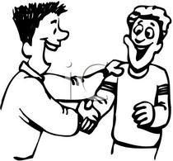
Peer Video Modeling
Example: Three different ways to greet others
Example: Hand washing

Slide 19
Video Self-Modeling
How to set the Table
How to make a bed

Slide 20
Point of View Video Modeling
Cleaning up toys & Hand washing

Slide 21
Video Model Examples from NSTAAC
Using Video Modeling to Teach:
Food Preparation and Cooking Skill

Slide 22
video modeling experiences
Pilot study: Improving Social Skills in an Employment Setting
Purpose: Teach an adolescent with ID specific social skills relevant to her current job using a VM procedure
The Research Question: Does video-modeling increase job-specific social skills in an adult with ID?

Slide 23
Pilot Study: Method
Participant:
18 year old Caucasian female
Participated in the Kent State Transition Collaborative (KSTC)
Diagnosis of ID
Setting:
Employed at the Kent State Recreation Center
(Monday – Thursday, 9:00 – 11:30a.m.)
Dependent Variables:
Target Behaviors Identified:
initiating greeting, eye contact, farewell

Slide 24
Pilot Study: Method
Independent Variable:
Video with narration: 3 – 30 second video clips depicting a peer engaging in the identified target behaviors
Video Clip 1 | Video Clip 2 | Video Clip 3
Eye Contact | Greeting | Farewell
Notes:
Independent Variable:
Video with narration: 3 – 30 second video clips depicting a peer engaging in the identified target behaviors

Slide 25
The Data

Slide 26
Pilot Study #2
Participant:
19 year old Caucasian male
Participant in the Kent State Transition Collaborative (KSTC)
Diagnosis of ASD
Setting:
Employment: Delivering Mail in White Hall (Monday – Thursday, 9:00 – 11:30a.m.)
Dependent Variables:
Target behaviors identified: initiating greeting, eye contact, & farewell

Slide 27
Method
Independent Variable:
Video with narration: 3 – 30 second video clips depicting a peer engaging in the identified target behaviors
Video Clip 1 | Video Clip 2 | Video Clip 3
Initiating Greeting | Eye Contact | Farewell

Slide 28
The Data
Notes:
PND for EyeContact: 92%
PND for Greeting 100%
PND for Farewell 100%

Slide 29
Discussion Question 1
What are some socially related employment skills that could be improved by video modeling?

Slide 30
Recap of the Research on Video Modeling
Effective with:
Reducing problem behaviors
Social skills
Communication
Daily living skills
Job skills
Functional skills
Academic engagement

Slide 31
Discussion Question 2
What are some advantages of video modeling?

Slide 32
Benefits of video modeling
Less stress & anxiety learning a new skill
Less distractions learning
Engages the learner
Repetition
Easy to create
Easy to implement
Faster rates of skill acquisition
Generalization

Slide 33
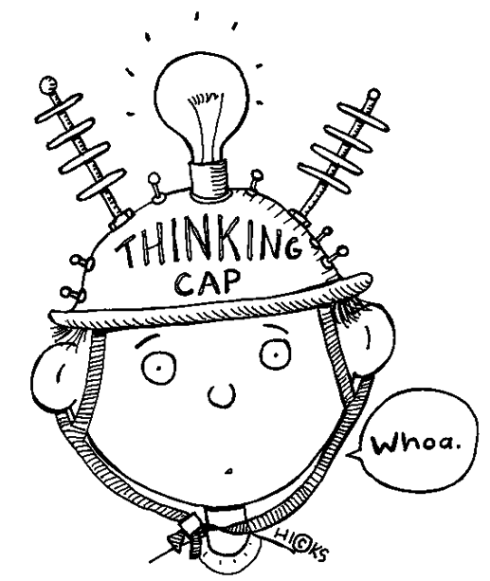
In closing
Describe a potential setting in which you might use a video modeling intervention.

Slide 34
Questions?

Slide 35
Video Modeling References
Bellini, S., & Akullian, J. (2007). A meta-analysis of video modeling and video self-modeling interventions for children and adolescents with autism spectrum disorders. Exceptional Children, 73, 264-287.
Cihak, D.F.,Fahrenkrog, C., Ayres, K.M., & Smith, C. (2012). The use of video modeling via a video iPod and a system of least prompts to improve transitional behaviors for students with autism spectrum disorders in the general education classroom. Journal of Positive Behavior Interventions, 12, 103-115.
Mason, R. A., Ganz, J. B., Parker, R. I., Burke, M. D., & Camargo, S. P. (2012). Moderating factors of video-modeling with other as model: A meta-analysis of single-case studies. Research in developmental disabilities, 33(4), 1076-1086.
Mechling, L. C., Pridgen, L. S., & Cronin, B. A. (2005). Computer-based video instruction to teach students with intellectual disabilities to verbally respond to questions and make purchases in fast food restaurants. Education and Training in Developmental Disabilities, 40(1), 47-59.
National Secondary Transition Technical Assistance Center. Evidence-based practices in secondary transition. Retrieved November 15, 2014, from http://www.nsttac.org/content/evidence-based-practices-secondary-transition
National Professional Development Center on Autism Spectrum Disorders. Evidence-Based Practice: Video Modeling. Retrieved November 15, 2014, from http://autismpdc.fpg.unc.edu/content/video-modeling

