Slide 1
Instructional Strategies for Improving Learning Outcomes in Mixed Ability Classrooms Grades 4 and up! Spring Teacher Academy OAGC 2017
Carol Sparber, Ph.D.

Slide 2
Objectives
Learn research-based instructional strategies
Understand the significance for using research-based strategies in teaching and instruction
Learn how to implement research-based instructional strategies

Slide 3
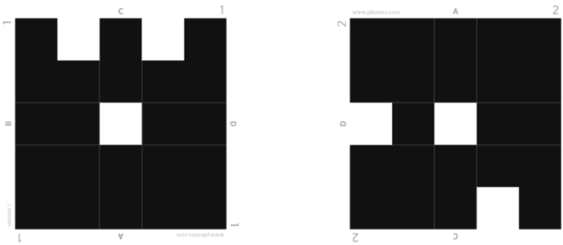
Plickers Assessment

Slide 4
What is a mixed-ability classroom?
A classroom with a variety of student needs….
gifted and talented
students with specific learning needs
Students on IEPs
Students from a variety of cultural backgrounds
Students from a variety of socioeconomic backgrounds

Slide 5
For example…
Connor likes coming to school because people don’t yell all the time – no one hits at school either, and if they do, they get in trouble
Katie knows she doesn’t learn like other kids. She has an aide who helps her in class. She doesn’t like feeling different.
Timmy hates reading. He misbehaves sometimes – not that he wants to, but because he doesn’t want to appear ‘stupid’ in front of everyone.

Slide 6
For example…
Emma reads her mom’s novels at home. She likes to write short stories in her free time. At school she’s working well above grade level.
Keh Keh is a refugee from Burma. She has an ELL tutor and is learning English but she has difficulty understanding the teacher and is uncomfortable asking questions.
Petra enjoys learning and wants to participate in classroom discussions – but he doesn’t. His friends say school is not for kids like them. Learning is for other kids, so why should he bother. He’ll never go to college anyways.

Slide 7
Student Characteristics in a mixed-ability classroom
Strengths
Superior Vocabulary
Highly creative
Resourceful
Curious
Imaginative
Questioning
Problem-solving ability
Sophisticated sense of humor
Wide range of interests
Advanced ideas & opinions
Special talent or consuming interest
Challenges
Easily frustrated
Stubborn
Manipulative
Opinionated
Argumentative
Difficulty with written expression
Highly sensitive to criticism
Inconsistent academic performance
Lack of organization and study skills
Difficulty with social interactions
Language barriers

Slide 8
Principles of learning
Learners must make meaning of what teachers seek to teach (National Research Council, 1990)
Learning takes place most effectively in classrooms where knowledge is clearly and powerfully organized (National Research Council, 1990)
Learners are actively engaged in the learning process (Wiggins & McTighe, 1998)
Learners need to feel a sense of safety and connection (Wiggins & McTighe, 1998)
Notes:
We know a lot about how people learn. We know that each learner must make meaning of what teachers seek to teach. We know that the meaning-making process is influenced by the student's prior understandings, interests, beliefs, how the student learns best, and the student's attitudes about self and school.
We know that learning takes place most effectively in classrooms where knowledge is clearly and powerfully organized, We know that learning takes place when students are highly active in the learning process.
(Vygotsky) Learning happens best when a learning experience pushes the learner a bit beyond his or her independence level. When a student continues to work on understandings and skills already mastered, little if any new learning takes place. On the other hand, if tasks are far ahead of a student's current point of mastery, frustration results and learning does not.
(Piaget)We know that motivation to learn increases when we feel a kinship with, interest in, or passion for what we are attempting to learn.

Slide 9
Commonly suggested strategies
Use preferential seating
Provide organizational techniques
Teach compensation strategies
Use technology
Notes:
Compensation strategies include: study strategies, cognitive strategies (also called learning strategies), compensatory supports (e.g., tape recorders and computer word processing programs), and environmental accommodations such as test-taking accommodations (e.g., extended test time, less distracting test-taking setting) Specific learning strategies (e.g., repetition, verbal elaboration, organization techniques, paraphrasing, association) & self-regulation.

Slide 10
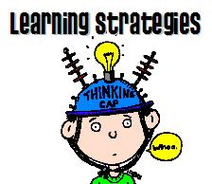
Introducing…
Practical, research-based instructional strategies
Based on principles of universal design for learning
Support and enhance all student’s academic success
Research indicates that content instruction paired with specific learning strategies improves student learning
Notes:
Research indicates that content instruction paired with specific learning strategies improves student learning

Slide 11
Collaborative effort
The University of Kansas
Kent State University
Teachers
Parents*
Students*

Slide 12
Development of Instructional Strategies
Principles of UDL
Differentiated instruction
Cooperative learning
Using evidence-based instructional approaches
1. direct instruction
2. indirect instruction
3. experiential learning
4. independent study
5. interactive instruction
Notes:
Universal Design for Learning (UDL) is an educational framework based on research in the learning sciences, including cognitive neuroscience, that guides the development of flexible learning environments that can accommodate individuallearning differences.

Slide 13
Seven Modules of Training
MODULE 1: Presenting Content- covers 3 of the most powerful evidence-based practices shown to improve performance of all students: (a) graphic organizers, (b) enhanced graphic text, and (c) sound fields.
MODULE 2: Engaging Students –offers 4 evidence-based learning strategies to remember and retain information:(a) guided notes, (b) mnemonics, (c) feedback and reinforcement, and (d) task analyses
MODULE 3: Flexible Assignments- presents 2 evidence-based practices that provide flexibility in the way students respond to content: (a) differentiated assignments and (b) cooperative learning strategies.
*MODULE 4: Providing Accommodations - provides an overview of: (a) special education law, (b) gifted education law, and (c) resources for accommodations.

Slide 14
Seven Modules of Training
MODULE 5: Classroom Strategies – covers: (a) creating the learning environment, (b) managing groups, and (c) creating quality assignments
MODULE 6: Individual Problem Solving - focuses on how to problem solve for 4 types of students: (a) unmotivated, (b) learning disabled, (c) behaviorally difficult, and (c) sensory and mobility impaired
MODULE 7: Creating Learning Communities - addresses how teachers can take control of their professional development and delve into Universal Design for Learning.

Slide 15
Module 1 Presenting Content Example:
The Lesson Organizer

Slide 16
Lesson Organizer (follow number order) Date:
3. Last Unit: (review last unit/ lesson)
1. Current Unit: (introduce using title)
4. Next Unit: (show how unit/lesson leads to next)
5. Big question:
(Discuss why this unit/lesson is important and relevant)
6. The Key Concepts
(3-6 short ideas-use back to show relationships or subheadings)
2. What is this about? (Discuss with Students)
USE
SHORT
& COLORS
EASY
NAMES
7. Self-test questions
8. Unit Schedule
(Describe what should students be able to do after studying
this unit)
(Describe key activities and
timelines)

Slide 17
Module 2 Engaging Students
Guided notes
“T-method”
Mnemonic strategies

Slide 18
Guided Notes
Guided notes are a strongly supported EBP that includes:
Having students fill in blanks in graphic organizers
Having students fill in blanks in outlines
Having students fill in key words instead of taking notes

Slide 19
Example of a guided notes question
Guided Notes—5th Grade Writing
A ________________ is a group of _________________ that tell about one ____________.
The _____________________ in a paragraph usually comes ________ and tells the main idea of the paragraph.
Sometimes, though, the topic sentence can come at the ___________ or in the ___________ of a paragraph.
When looking for a ___________ sentence, try to find the one that tells the ______________ of the paragraph.
__________________________ follow the topic sentence and provide details about the topic.

Slide 20
The “T” Method of Taking Notes

Slide 21
Key word Mnemonics
Mnemonics: good for remembering facts or events
Connects new learning to prior knowledge through the use of visual cues
HOMES” to remember Great Lakes, Huron, Ontario, Michigan, Erie, and Superior
PEMDAS – to remember the order of operations: parentheses, exponents, multiply, divide, add, subtract
When mnemonics are used correctly, they can streamline the learning process, giving students access to broad amounts of information. Because they learn "bridges" to other information, less working memory is required.

Slide 22
Module 3 Flexible Assignments
Whole class feedback
Differentiated assignments
(e.g., Think Tac Toe)
Cooperative learning
(e.g., Jigsaw)

Slide 23
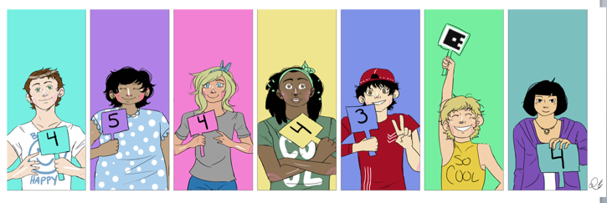
Example of whole-class feedback
Erasable boards for whole class responses
Use computer apps such as “Plickers” for whole class responses

Slide 24
Differentiated Assignment example
Think Tac Toe (Tomlinson, 2001)
Kinesthetic Whole body games, movement activities, making models, following instructions to make something, setting up experiments | Knowledge list, define, tell, describe, identify, show, label, collect, examine, quote, name, who, when, where | Auditory interviewing, debating participating on a panel giving oral reports participating in oral discussions of written material
Comprehension Summarize, describe, interpret, contrast, predict, associate, distinguish, estimate, discuss, extend | Core Content information is presented in sequential steps, lessons are structured and teacher-directed goals are clear requirements are spelled out | Synthesis combine, integrate, modify, rearrange, substitute, plan, create, design, invent, what if?, compose, formulate, prepare, generalize, rewrite
Visual computer graphics maps, graphs, charts, cartoons, posters, diagrams, graphic organizers, text with a lot of pictures | Evaluation assess, decide, rank, grade, test, measure, recommend, convince, select, judge, explain, discriminate, support, conclude, compare | Tactile Drawing, playing board games, making dioramas, making models, following instructions to make something

Slide 25
Cooperative Learning example: Jigsaw
Notes:
Examples of Modules 4, 5, & 6 we’ll leave for another day

Slide 26
How these techniques help you as a teacher
support homework and monitor assignments
less frustrated students
fewer students non-engaged
fewer students feeling distracted by other students
promotes student achievement without extensive individual interventions

Slide 27
Concept Comparison Routine
“The concept comparison routine makes teachers more organized, takes kids to a higher level of thinking… instead of just writing down information, students have to organize it, analyze it, and come up with ideas themselves.”
Kaye Neill
Science teacher

Slide 28
Concept Comparison Routine
The purpose:
Helps a diverse group of students understand and master key concepts.
Helps students understand two or more related concepts by analyzing how those concepts are the same and how they are different.
When students have a clear understanding of how concepts are alike and different understanding increases significantly.

Slide 29
Research on the Concept Comparison Routine
Highly effective with ALL students
Students w/LD and low achieving students increased test scores associated with information presented through the use of the routine by 15%
Average and high achieving students increased test scores associated with information presented through the use of the routine by 24%
Effective for students in upper elementary through high school

Slide 30
Concept Comparison Routine
Communicate targeted concepts
Organize overall concepts
Make lists of known characteristics
Pin down like characteristics
Assemble like categories
Record unlike characteristics
Identify unlike categories
Nail down a summary
Go beyond the basics

Slide 31
Comparison Table
2. Overall Concept: Economic causes of sectionalism in the U.S.
Communicate targeted concepts
Overall concept
Make lists of known characteristics
Pin down like characteristics
Assemble like categories
Record unlike characteristics
Identify unlike categories
Nail down a summary
Go beyond the basics
1. Concept: Economic conditions in the North in 1860
1. Concept: Economic conditions in the South in 1860
3. Characteristics
Good ports
Good natural resources
Immigrants in labor force
Profit from industries
Good land transportation
Good credit with other countries
3. Characteristics
Good ports
Good natural resources
Slaves in labor force
Profit from growing cotton
Poor land transportation
Good credit with other countries
9. Extensions: Study the economic conditions of the West in 1860, and create _______________________.
4. Like Characteristics
Good ports
Good natural resources
Good credit with other countries
5. Like Categories
Quality of ports
Quality of natural resources
Quality of credit
6. Unlike Characteristics
Immigrants in labor force
Profit from industries
Good land transportation
6. Unlike Characteristics
Slaves in labor force
Profit from growing cotton
Poor land transportation
7. Unlike Categories
Primary source of labor
Source of profits
Quality of land transportation
8.Summary: Sectionalism in the U.S. was partially caused by economic conditions in the North and South in 1860. Although the North & South both had good natural resources, ports, and credit, their primary sources of labor and profits were different, as was the quality of their land transportation. These three differences probably contributed to sectionalism.
Notes:
As the United States moved closer to civil war, the country divided more and more. Sectionalism became a problem. This is the loyalty to a part of a nation, but not the nation as a whole. Americans saw themselves as Southerners or Northerners.

Slide 32
Teaching the Concept Comparison
Rationale (focus on important concepts, confidence in discussions, expert at analyzing concepts, identify relationships among other concepts)
1.Explain the purpose (helps learn information in a new way)
2. Define (helps analyze, identify, explore, & summarize)
3. Model with students
4. Students complete in small groups

Slide 33
2. Overall Concept:.
Communicate targeted concepts
Overall concepts
Make lists of known characteristics
Pin down like characteristics
Assemble like categories
Record unlike characteristics
Identify unlike categories
Nail down a summary
Go beyond the basics
1. Concept:
1. Concept:
3. Characteristics
3. Characteristics
9. Extensions:
4. Like Characteristics
5. Like Categories
6. Unlike Characteristics
6. Unlike Characteristics
7. Unlike Categories
8.Summary:
Notes:
1.Begin by writing the names of the concepts being compared
2. Enter name of Overall concept
3. Create lists of known characteristics (teacher does ahead of time to help identify questions to help students)
4. Identify like characteristics
5. Create names for the like categories
6. Identify characteristics that are different – yet related
7. Create names of Unlike categories
8. Create a summary
9. Extend student understanding

Slide 34
Possible topics
Mammals & Birds
Stratus & Cumulus clouds
Cooperation & Competition
Fractions & Decimals
Plot & Theme
WWI & WWII
Sonnets and Ballads
Prokaryotes and Eukaryotes

Slide 35
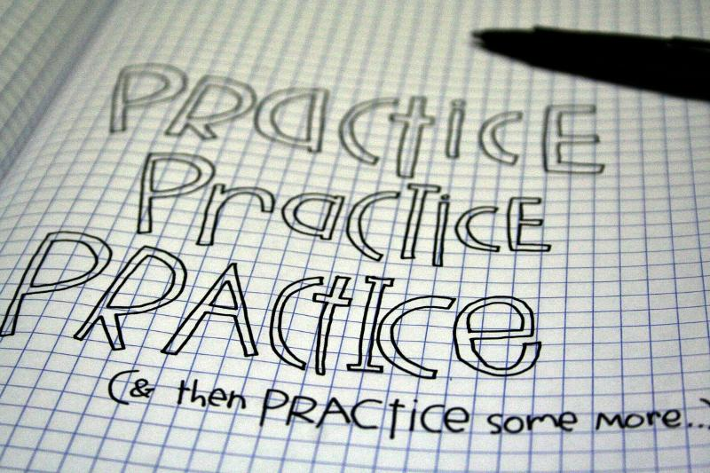
Time to practice

Slide 36
Share & Discuss

Slide 37
Why would this instructional strategy work for a mixed ability classroom?
Notes:
Helps students organize information. Frames the parts of the whole. Lends itself to flexible grouping. It’s student centered, Visual graphs/charts support learning, Frames relationships, Incorporates organizational activities into classroom activities, Breaks learning into steps, Helps students synthesize information, Organizes learning

Slide 38
Part 2
Instructional Strategies for Improving Learning Outcomes in Mixed Ability Classrooms

Slide 39
Introducing more learning strategies…
Practical, research-based instructional strategies
Based on principles of universal design for learning
Support and enhance all student’s academic success
Research indicates that content instruction paired with specific learning strategies improves student learning
Notes:
Research indicates that content instruction paired with specific learning strategies improves student learning

Slide 40
Development of Instructional Strategies
Principles of UDL
Differentiated instruction
Cooperative learning
Using evidence-based instructional approaches
1. direct instruction
2. indirect instruction
3. experiential learning
4. independent study
5. interactive instruction

Slide 41
The LINCing Routine

Slide 42
Purpose of the LINCing Routine
To help a diverse group of students learn and remember the meaning of important terms.
Gets students ready to learn new terms
Co-construct visual and auditory memory devices
Check student understanding

Slide 43
What the Research says about the LINCing Routine
Extensively researched
Promotes understanding and recall of an important vocabulary term
Highly effective with ALL students
When consistently used with students for 3 weeks, students w/LD increased vocabulary scores 24%-29%
Students without LD increased vocabulary scores 16% – 19%
Most effective with middle school – high school age students, can be used effectively with upper elementary

Slide 44
Mnemonics using LINCing Routine

Slide 45
Mnemonics using LINCing Routine
Step 1. The term: discuss and define the meaning of the word within the context of the lesson. Record the term on the form.
Term
Discount

Slide 46
Mnemonics using the LINCing Routine
Step 2. A brief definition is written in section 2. Use ONLY the parts of the definition that are most essential for students to know. (reduce long definitions to their most essential parts)
1. Term
Discount
2. Definition
The difference between the list price and sale price

Slide 47
Mnemonics using LINCing Routine
Step 3 The reminding word gives students auditory clues that will enable the to access their memory of the new term and the new term’s definition. It must SOUND similar to part of all of the new term, and it must be a real word whose meaning is very familiar to the students. It should help you remember what the new word means.
1. Term
Discount
2. Definition
The difference between the list price and sale price
3. Reminding Word
Disc

Slide 48
Mnemonics using LINCing Routine
Step 4 The LINCing story is a short phrase or sentence that enables students to connect or link the meaning of the new term to familiar background knowledge.
It provides auditory and visual links between the reminding word and the meaning of the new term.
AN EFFECTIVE story includes several characteristics:
the story always contains the reminding word, the story always contains the meaning of the new term in some way, the story is always short and simple.
1. Term
Discount
4. The LINCing story
I saved three dollars on a disc
2. Definition
The difference between the list price and sale price
3. Reminding word
Disc

Slide 49
Examples and Nonexamples
Decree: to make a decision and force it on others. Reminding word: Decide LINCing Story: “the dictator decided to force everyone to pay higher taxes.” (The story helps you think of a decision being forced on others.) ______________________________ Flourite: a purple mineral used to make steel hard. Reminding word: Floor LINKing Story: “My knee turned purple when it hit the hard, steel floor.” (Story helps you think of steel and the color purple.) | Decree: to make a decision and force it on others. Reminding word: Decide LINCing Story: “He decided to go to town.” (Story does not help you think of forcing a decision on others.) ______________________ Flourite: a purple mineral used to make steel hard. Reminding word: Floor LINKing Story: “The floor was messy.” (Story does not help you think of steel or the color purple.)

Slide 50
Step 5 The LINCing picture provides a visual memory link for the new term.
The picture does not need to be sophisticated artwork – stick figures are fine.
The linking pictures must include 3 characteristics: It MUST depict: a part related to the Reminding word, contains parts related to the important ideas in the definition, and it must help the student remember the new term’s definition.
1. Term
Discount
4. The LINCing story
I saved three dollars on a disc
5. The LINCing picture
2. Definition
The difference between the list price and sale price
3. Reminding word
Disc

Slide 51
An Effective LINCing Picture

Slide 52
Group practice: Term ‘compromise’
Term
compromise
4. Story
5. Picture
2. Definition
3. Reminding Term

Slide 53
Mnemonics using LINCing Routine
USE the Mnemnic to practice the Routine
List the parts
Identify a Reminding word
Note a LINCing story
Create a LINCing picture

Slide 54
Word Choices
Amendment Serpentine Clamor
Charitable Countenance Tremulous
Mortified Grotesque Allude
Tirade Exquisite Placid
Perpetual Melancholy Amiable
Wholesale Incredulous Venerate
Abolitionist Perplex Undulate

Slide 55
Share & Discuss

Slide 56
Why would this instructional strategy work for a mixed ability classroom?
Notes:
Visual graphs/charts support learning
Frames relationships
Show the ‘parts’ of the ‘whole’
Incorporates organizational activities into classroom activities
Breaks learning into steps
Helps students synthesize information
Organizes learning

Slide 57
Lesson Organizer Activity
The difference
between good and poor learners
is not the sheer quantity
of what the good learner learns,
but rather
the good learner’s ability
to organize and use information.

Slide 58
What the Research says about the Lesson Organizer…
Research conducted over an eight-month period
Results: understanding and retention of information by all students improved substantially.
Teaching instruction changed:
teachers clearly explained what was to be learned
teachers expounded on the relationships between ‘chunks’ of information
Teachers explained relevance of activities used to support learning
Students of teachers who used the graphic organizer regularly and consistently scored an average of 15 percentage points higher on unit tests than students of teachers who did not use organizers

Slide 59
What I observed when my child tried to study….
Visual graphs/charts support learning
Frames relationships
Show the ‘parts’ of the ‘whole’
Incorporates organizational activities into classroom activities
Breaks learning into steps
Helps students synthesize information
Organizes learning

Slide 60
2. ELA 8-9 Writing Lesson Organizer: Writing Informative Texts Date:
3. Last Topic
Write arguments
1. Current Topic
Write informative texts
4. Next Topic
Write narratives
5. Big Question (the Standard): How do I communicate
complex ideas clearly and accurately?
6. The Key Concepts
2. Ask students: What do you already know?
Introduce a topic
Provide background Information
Provide a conclusion
Link major ideas
Use formal language
8. Unit Schedule
7. Self-test Questions
Describe and find examples of each of the five key elements of informative text from a case study
Discuss the purpose of informative text and give examples of where this style might be used
From an informative text of your choice, identify what background information is provided
From an informative text of your choice, give examples of statements written from an objective point of view
From an informative text of your choice, give examples of statements that include formal language or words
Describe the key elements of a conclusion
Discuss the topic and fill out the lesson organizer along with the teacher (Day 1)
Participate in writing examples of the key elements with the teacher (Day 1)
Divide into groups and write an informative text with the five key elements (Day 2)
Each group presents their informative text for critical analysis (Day 2)
Assignment: Develop an informative text and bring to class to discuss and hand in (Day 3)

Slide 61
4. Big Picture: Forms of Government
2. Last Topic
Current Topic:
Democracy
3. Next Topic
8. | Unit Schedule
2/28
2/29
3//1
3/2
3/3
3/6
3/7
3/8
3/9
5.Unit/Lesson Map
Is about…
Equal say…
2. Ask students: What do you already know?
Direct
Indirect
7.Self-test questions
How is political power organized in the United States?
Hierarchy
6. Relationships Key Concepts
How are direct and indirect democracies different?
Contrast
Notes:
Can use these type of organizers to teach any subject
Teach how to work in a cooperative learning group
Organizers like this help teachers pull together multiple sources together to create a unit or a lesson.
As you create the organizer together, ask questions to check understanding and clarify misconceptions
The organizer works as a mini-syllabus for kids.
It does take a few minutes to develop the organizers with kids – but the research shows those

Slide 62
4. Big Picture:
2. Last Topic
1. Current Topic
3. Next Topic
8. | Unit Schedule
2/28
2/29
3//1
3/2
3/3
3/6
/7
3/8
3/9
5.Unit/Lesson Map
7.Self-test questions
6. Relationships
Notes:
CRAFT
Create a context so students see how current information is connected to previous and future learning
Recognize content structures – so students can see how information is related (5. map or 9. expanded map)
Acknowledge unit relationships – students look for and identify possible relationships that might be important
Frame unit questions – student generated questions,
Tie Content to tasks – help students see how content and tasks are related

Slide 63
Time to practice

Slide 64
Share & Discuss

Slide 65
Why would this instructional strategy work for a mixed ability classroom?

Slide 66
Benefits of Lesson Organizers
Provides accommodations/adaptations to access learning:
Visual graphs/charts support learning
Frames relationships
Show the ‘parts’ of the ‘whole’
Incorporates organizational activities into classroom activities
Breaks learning into steps
Helps students synthesize information
Organizes learning

Slide 67
Wrap Up
Strategies
Graphic organizers (framing routines/UDL)
Guided notes/T-Method (concept mastery)
Mnemonic strategies (concept LINCing routines)
Think Tac Toe (Differentiation)
Jigsaw (Cooperative learning)

Slide 68
More information
http://www.livebinders.com/play/play?id=2163392
Instructional Strategies for Mixed Ability Classrooms
Contact information:
Carol Sparber Ph.D.
150 Terrace Drive, 202 White Hall
Kent, OH 44242
330-672-0723
csfeldma@kent.edu

