Slide 1
Universal Design Strategies for Mixed-Ability Classrooms
DCDT 2016
Robert Baer, Kent State University
Alfred Daviso III, University of Akron
Carol Feldman-Spaber, Kent State University
Tina DeTano Bastock, Kent State University
Contact: rbaer@kent.edu

Slide 2
Purpose
This training was initially developed in 2010 for career-tech teachers serving mixed-ability students. See www.cteproject.com
Was expanded in 2016 to include strategies for general and special education teachers
Is designed as an overview of evidence-based UDL practices with examples and activities
Is designed to address the components of UDL in the Higher Education Opportunity Act of 2008

Slide 3
UDL Definition
The Higher Education Opportunity Act defines UDL as a scientific framework for guiding educational practice that—
provides flexibility in the ways information is presented;
in the ways students respond or demonstrate knowledge and skills;
in the ways students are engaged;
reduces barriers in instruction, provides appropriate accommodations, supports, and challenges, and maintains high achievement expectations for all students, including students with disabilities and students who are limited English proficient §103(a)(24).

Slide 4
UDL Teacher Practice Training Components
MODULE 1: Presenting Content- This module covers three of the most powerful evidence-based practices shown to improve performance of all students, namely: (a) graphic organizers, (b) enhanced graphic text, and (c) sound fields.
MODULE 2: Engaging Students –This module covers four evidence-based learning strategies to remember and retain information, namely: (a) guided notes, (b) mnemonics, (c) feedback and reinforcement, and (d) task analyses
MODULE 3: Flexible Assignments- This module presents two evidence-based practices provide students flexibility in the ways they respond to content: (a) differentiated assignments and (b) cooperative learning strategies.
MODULE 4: Providing Accommodations - This module provides an overview of: (a) special education law, (b) laws governing career-technical education programs, (c) transition planning, and (d) resources for accommodations.

Slide 5
Advanced UDL Training Components
MODULE 5: Classroom Strategies – This module covers: (a) creating the learning environment, (b) managing groups, and (c) creating quality assignments
MODULE 6: Individual Problem Solving - This module focuses on how to problem solve for four types of students: (a) unmotivated, (b) learning disabled, (c) behaviorally difficult, and (c) sensory and mobility impaired
MODULE 7: Creating Learning Communities - This module addresses the issue of how teachers can take control of their professional development and delving into the UDL in this manual in greater detail.

Slide 6
Highlights of UDL Presentation Module-1
Features Strategic Instructional Methods (SIM) from the University of Kansas Center for Learning
Provides resources for developing graphic text
Discusses sound fields and how they can improve comprehension for all students
Leads teachers through an activity of presenting a lesson using a graphic lesson organizer
Groups map a content standard onto a SIM lesson organizer
Each group presents their lesson organizer as if teaching a class
Teachers must follow the numbered steps of the lesson routine

Slide 7
Organizer Matrix (follow number order) Date:
3. Last Unit: (review last unit info needed)
Current Unit: (introduce using title)
4. Next Unit: (show how unit leads to next)
5. Big question:
(Discuss why this unit is important and relevant)
6. The Key Concepts
(3-6 short ideas-use back to show relationships or subheadings)
2. What is this about? (Discuss with Students)
USE
SHORT
& COLORS
EASY
NAMES
7. Self-test questions
8. Unit Schedule
(Describe what should students be able to do after studying this unit).
(Describe key activities and timelines)
Notes:
Connecting the information to what they already know (1-4)
Describing the content and why it is important (5)
Identifying key concepts (6)
Showing the relationship between these key concepts (6)
Identifying what questions the students will need to be able to answer from the unit or lesson (7)
Identifying the tasks that the students will be expected to participate in or complete (8)

Slide 8
Highlights of UDL Engagement Module-2
Includes EBP methods for supporting students in taking notes including guided notes and the “T-method”
Includes EBP mnemonic strategies including key words and acronyms
Includes whole-class strategies to facilitate whole-class feedback such as eraser boards, “Plickers”
Includes task analyses and reinforcement strategies
Engages groups in developing a task analysis
Using a common household task
With a mnemonic to remember the steps in the task analysis

Slide 9
Cross out steps completed independently
Circle total number of steps completed
Connect circles to create graph of progress

Slide 10
Highlights of UDL Flexible Assignment Module-3
Features “Think Tac Toe method”(Tomlinson) for differentiating ways that students can respond to an assignment
Describes the “Jigsaw” approach to developing cooperative learning assignments
Engages participants in planning a picnic fundraiser with differentiated assignments that emphasize
Academic skills
Applied skills
Interpersonal skills
Artistic skills

Slide 11
Some possible forms of differentiation using the
“Think Tac Toe” matrix
Kinesthetic Whole body games, movement activities, making models, following instructions to make something, setting up experiments | Knowledge list, define, tell, describe, identify, show, label, collect, examine, quote, name, who, when, where | Auditory interviewing, debating participating on a panel giving oral reports participating in oral discussions of written material
Comprehension Summarize, describe, interpret, contrast, predict, associate, distinguish, estimate, discuss, extend | Core Content information is presented in sequential steps, lessons are structured and teacher-directed goals are clear requirements are spelled out | Synthesis combine, integrate, modify, rearrange, substitute, plan, create, design, invent, what if?, compose, formulate, prepare, generalize, rewrite
Visual computer graphics maps, graphs, charts, cartoons, posters, diagrams, graphic organizers, text with a lot of pictures | Evaluation assess, decide, rank, grade, test, measure, recommend, convince, select, judge, explain, discriminate, support, conclude, compare | Tactile Drawing, playing board games, making dioramas, making models, following instructions to make something

Slide 12
Highlights of Providing Accommodations Module-4
Provides an overview of special education legislation regarding accommodations including: Free appropriate public education (FAPE); Least-restrictive environment (LRE); Individual Education Programs (IEPs); and Multi-Factored Evaluations (MFE or ETR)
Provides an overview of legislation for participation in career-technical education including: Equal access to enrollment; participation in IEPs planning and delivery; and provision of transition and supplemental services
Provides an overview of laws governing workplace accommodations including: essential elements of a job; reasonable accommodations; and undue hardship constraints
Provides resources for locating effective and low-cost accommodations
Provides a rationale for selecting career-technical education courses of study that include preparation for: (a) employment, (b) postsecondary education, or (c) meeting industrial standards.

Slide 13
Case Studies – Module 4
A student wants to enter an auto mechanic career-technical program but will not be able to obtain ASE certification. He wants work at Jiffy Lube after leaving high school. Should the career-technical auto mechanics program be expected to enroll him?
A student wants to enter a cosmetology program but will not be able to obtain cosmetology certification. The student wants to attend this program because she likes to style her own hair. Should the career-technical cosmetology program be expected to enroll her?

Slide 14
Highlights of Classroom Management Module-5
Provides an overview of co-teaching strategies
Discusses the learning environment and how to structure a classroom.
Provides an overview of how to use graphics and scaffolding to allow all students to participate in discussion of advanced concepts
Discusses grading strategies for mixed-ability classrooms where students have different learning goals

Slide 15
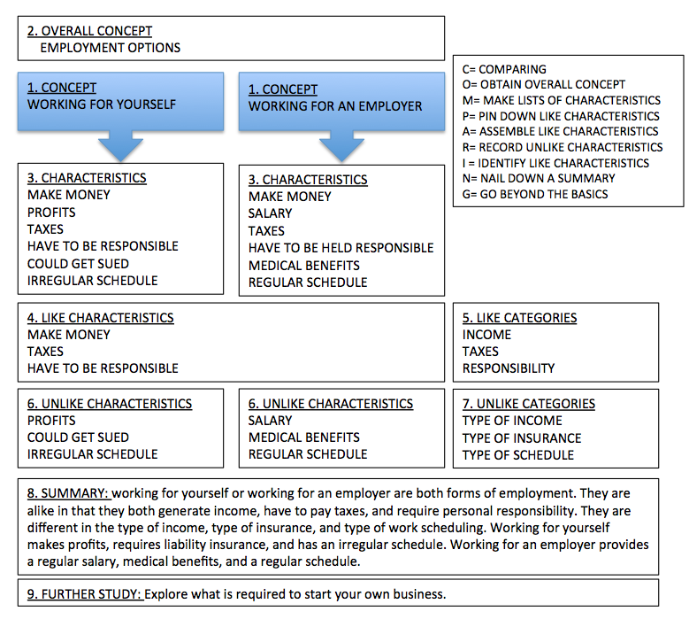
Group activity for Module 5:
Divide into groups of 4-6
Identify two concepts for comparison (e.g., male vs. female)
Follow the steps in the Concept Comparison Routine to develop a summary statement

Slide 16
Highlights of Individual Problem Solving Module-6
Provides an overview of Positive Behavior Intervention and Supports (PBIS) systems
Identifies four common barriers to learning and their causes:
Lack of motivation
Learning needs and barriers
Behavioral barriers
Physical and sensory barriers
Discusses EBP related to overcoming learning barriers in the context in which they are occurring

Slide 17
Case Studies – Module 6
A student constantly interrupts to gain attention of the teacher. How might a teacher set up class discussion to provide greater attention to other students in the class while rewarding appropriate behavior by the attention-seeking student?
A student with autism exhibits extreme avoidance behavior in the form of tantrum behavior when asked to transition from one task to the next. The cause of avoidance is severe anxiety. How might the teacher address this issue?

Slide 18
Highlight of Teacher Learning Communitie
Describes the challenges for teachers who need time for professional development
Describes how teachers need to take responsibility for improving their practice by establishing learning communities
Describes a five-step group process approach (Tuckman & Jensen, 1977)
Forming
Storming
Norming
Performing
Adjourning

Slide 19
Activity—Module 7
Divide into groups of 4-6
Develop a statement of an area that students need to learn (e.g., vocabulary)
Brainstorm evidence-based UDL to address learning need (e.g., LINCing routine)
Develop a possible way of freeing up time for professional development in this area
Identify the key components of professional development
Discuss how teachers can be supported after professional development

Slide 20
LINCing Routine Activity
Extensively researched
Promotes understanding and recall of an important vocabulary term
Highly effective with ALL students
When consistently used with students for 3 weeks, students w/LD increased vocabulary scores 24%-29%
Students without LD increased vocabulary scores 16% – 19%
Most effective with middle school – high school age students

Slide 21
Mnemonics using the LINCing routine
Extensively researched
Promotes understanding and recall of an important vocabulary term
Highly effective with ALL students
When consistently used with students for 3 weeks, students w/LD increased vocabulary scores 24%-29%
Students without LD increased vocabulary scores 16% – 19%
Most effective with middle school – high school age students

Slide 22
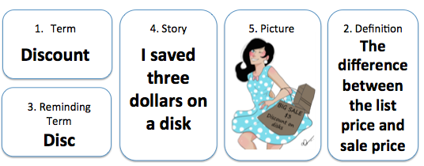
Mnemonics using LINCing Routine
Notes:
The Lincs table is made up of 5 different boxes. Specific information is recorded in each box – the Term, a Definition, a Reminding work, a Lincing story, and a Lincing Picture.
1st time you use this, you do it as a whole group activity. Eventually, students will learn to construct LINCS Tables without teacher assistance.
The term – discuss and define the meaning of the word within the context of the lesson. Record the term on the form.
A brief definition is written in section 2 – use ONLY the parts of the definition that are most essential for students to know. (reduce long definitions to their most essential parts)
The reminding word gives students auditory clues that will enable the to access their memory of the new term and the new term’s definition. It must SOUND similar to part of all of the new term, and it must be a word whose meaning is very familiar to the students.
The LINCing story is a short hrase or sentence that enables students to connect or link the meaning of the new term to familiar background knowledge. It provides auditory and visual links between the reminding word and the meaning of the new term. AN EFFECTIVE story includes several characteristics: the story always contains the reminding work, the story always contains the meaning of the new term in some way. The story sometimes contains the new term, the story is always short and simple
The LINCing picture is a memory device that provides a visual memory link for the new term. The picture does not need to be sophisticated artwork – stick figures are fine. The linking pictures must include 3 characteristics: It MUST depict, in some way, the essential features of the new term’s definition, it must contain a part related to the reminding word and it must help the student remember the new terms definition
Teaches students how to rephrase key ideas and link to key words.

Slide 23
Mnemonics using LINCing Routine
Step 1. The term: discuss and define the meaning of the word within the context of the lesson. Record the term on the form.
Term
Discount

Slide 24
Mnemonics using the LINCing Routine
Step 2. A brief definition is written in section 2. Use ONLY the parts of the definition that are most essential for students to know. (reduce long definitions to their most essential parts)
1. Term
Discount
2. Definition
The difference between the list price and sale price

Slide 25
Mnemonics using LINCing Routine
Step 3 The reminding word gives students auditory clues that will enable the to access their memory of the new term and the new term’s definition. It must SOUND similar to part of all of the new term, and it must be a real word whose meaning is very familiar to the students. It should help you remember what the new word means.
1. Term
Discount
2. Definition
The difference between the list price and sale price
3. Reminding Word
Disc

Slide 26
Mnemonics using LINCing Routine
Step 4 The LINCing story is a short phrase or sentence that enables students to connect or link the meaning of the new term to familiar background knowledge.
It provides auditory and visual links between the reminding word and the meaning of the new term.
AN EFFECTIVE story includes several characteristics:
the story always contains the reminding word, the story always contains the meaning of the new term in some way. The story is always short and simple
1. Term
Discount
4. The LINCing story
I saved three dollars on a disc
2. Definition
The difference between the list price and sale price
3. Reminding word
Disc

Slide 27
Examples and Non-examples
Decree: to make a decision and force it on others. Reminding word: Decide LINCing Story: “the dictator decided to force everyone to pay higher taxes.” (The story helps you think of a decision being forced on others.) __________________________________ Flourite: a purple mineral used to make steel hard. Reminding word: Floor LINKing Story: “My knee turned purple when it hit the hard, steel floor.” (Story helps you think of steel and the color purple.) | Decree: to make a decision and force it on others. Reminding word: Decide LINCing Story: “He decided to go to town.” (Story does not help you think of forcing a decision on others.) __________________________________ Flourite: a purple mineral used to make steel hard. Reminding word: Floor LINKing Story: “The floor was messy.” (Story does not help you think of steel or the color purple.)

Slide 28
Mnemonics using LINCing Routine
Step 5 The LINCing picture is a memory device that provides a visual memory link for the new term.
The picture does not need to be sophisticated artwork – stick figures are fine.
The linking pictures must include 3 characteristics: It MUST depict: a part related to the Reminding word, contains parts related to the important ideas in the definition, and it must help the student remember the new term’s definition.
1. Term
Discount
4. The LINCing story
I saved three dollars on a disc
5. The LINCing picture
2. Definition
The difference between the list price and sale price
3. Reminding word
Disc

Slide 29
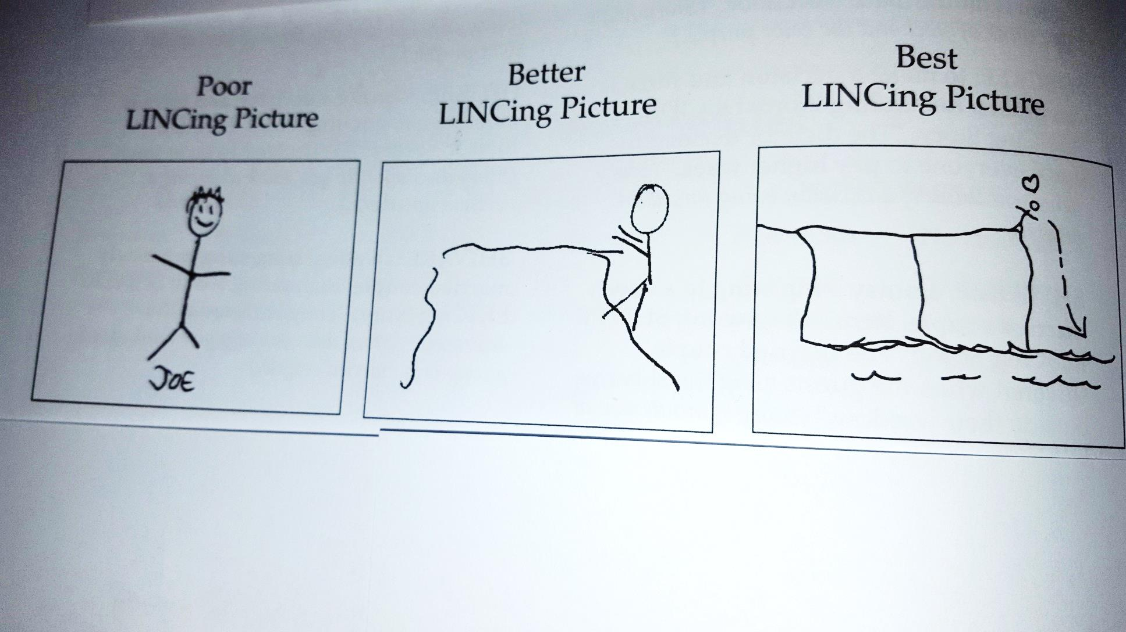
An Effective LINCing Picture

Slide 30
Group practice: Term ‘compromise’
Term:
compromise
4. Story:
5. Picture:
2. Definition:
3. Reminding Term:
Notes:
List the parts
Identify a reminding word
Note a LINCing story
Create a LINCing picture
Supervise practice
Can fold paper. Self test forward: Say new word, say reminding word, think of LINCing story, think of LINCing picture, Say the meaning of the new word. Check to see if you’re correct
Self test backward

Slide 31
Mnemonics using LINCing Routine
USE the Mnemnic to practice the Routine
List the parts
Identify a Reminding word
Note a LINCing story
Create a LINCing picture
Notes:
Hand out LINCing templates & practice
Discuss

Slide 32
Word Choices
Amendment
Charitable
Mortified
Tirade
Perpetual
Wholesale
Abolitionist

Slide 33
Conclusion
More Information:
LiveBinder
Manuals
Website: cteproject.com
Brochures

